Slide 1
Lab 1
Introduction into Conceptual modelling

Slide 2
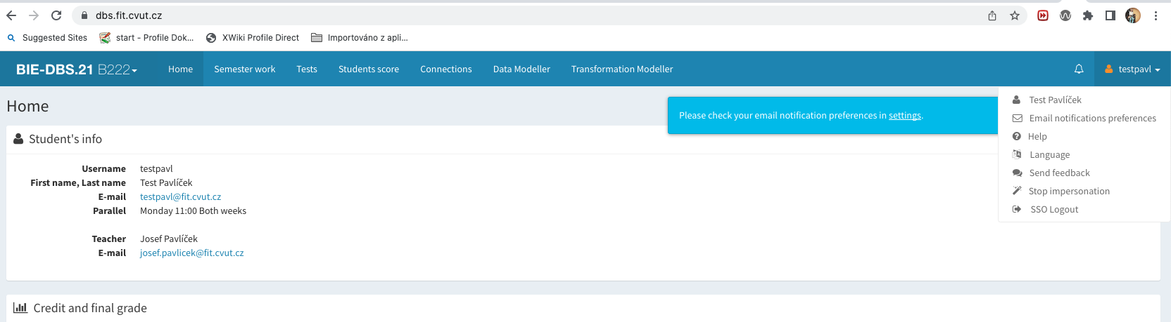
DBS portal
Login there https://dbs.fit.cvut.cz/
Switch to the english version

Slide 3
Semestral work editor
For opening Semestra work editor, press this tab

Slide 4
Data modeller
For opening Data Modeller, press this tab

Slide 5
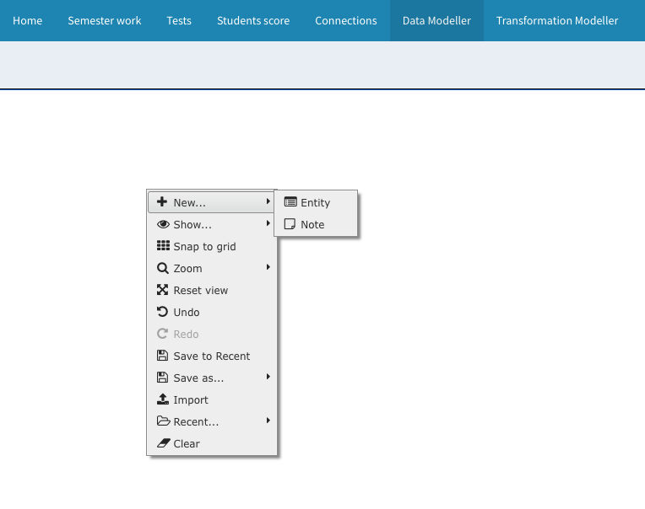
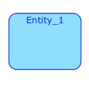
Data modeller
Klik into canvas for adding entity
Press right mouse button for modeller menu

Slide 6
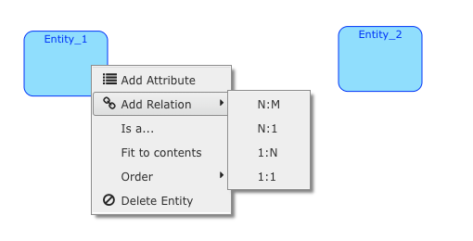
Add relation in Data Modeller
For adding Attribute or adding Relation select entity and active the menu by right mouse button.

Slide 7
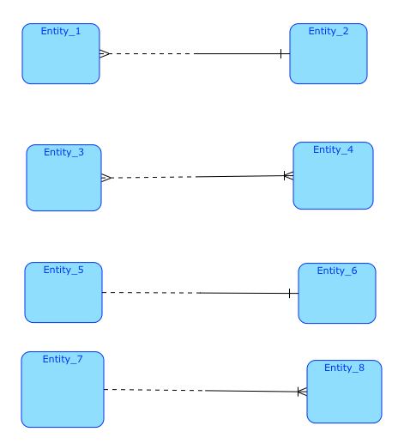
Be careful
Be careful, Modeller adds the “Identify” symbol even if it is logical nonsense.

Slide 8
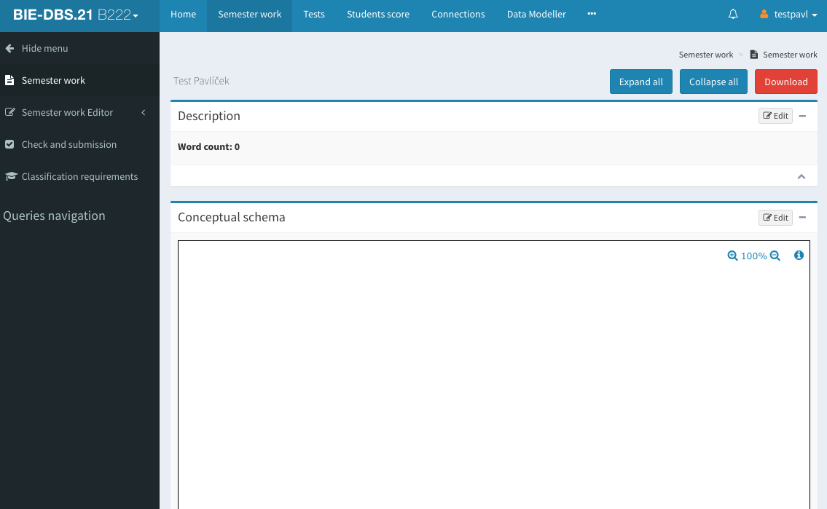
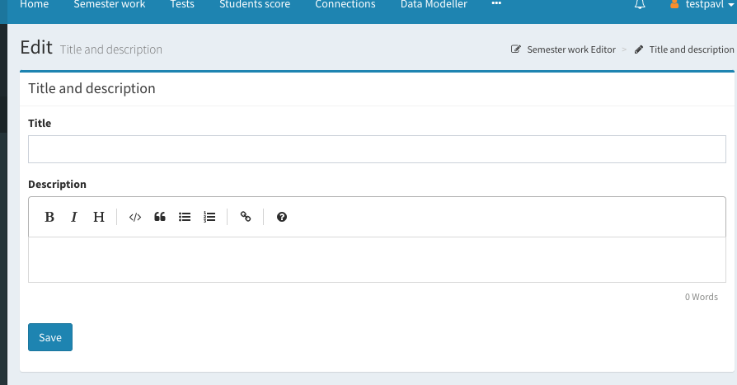
The task for today
You have to fill the semestral project title and description:
Go to the Semester Work
Select edit button in Description
you can start editing

Slide 9
The task for today
If you want to start with conceptual modeling, you can continue similar:
Go to the Semestral Work
Select edit button in Conceptual schema
you can start editing

Slide 10
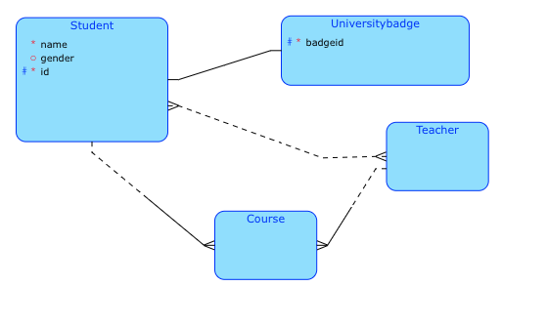
DBS portal
Create entity Student, UniversityBadge, Teacher
add the Student attributes:
name - mandatory
gender - nullable
id (primary key)
add the UniverisityBadge attribute:
bageid (primary key)
Try to make relations between them

